Slide 1

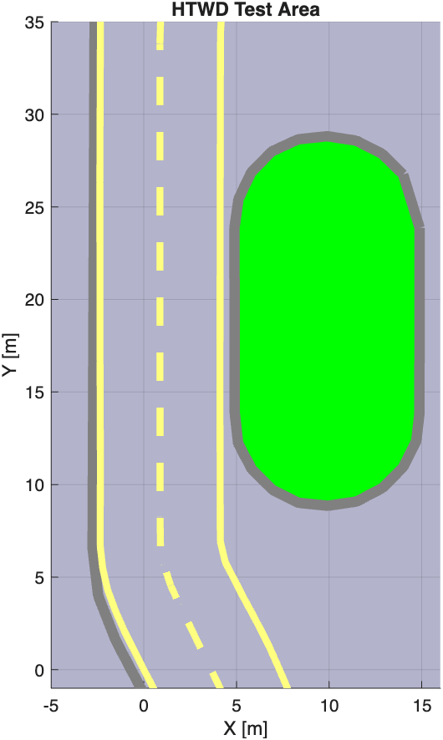
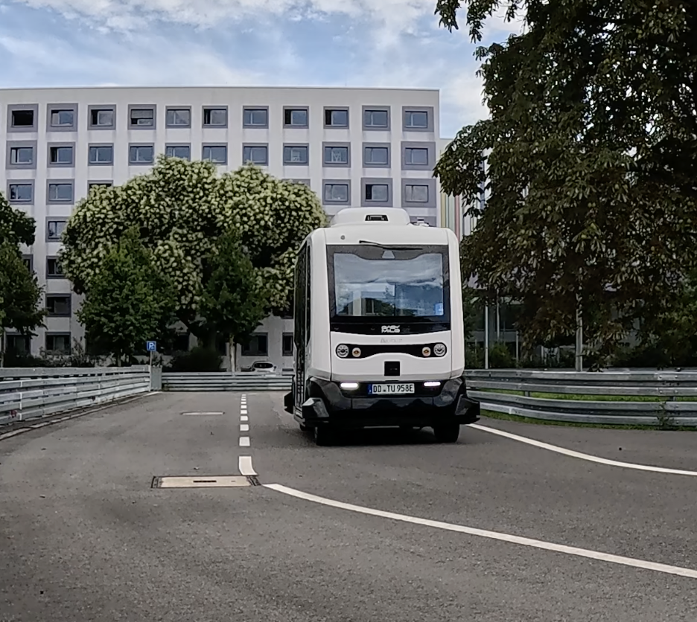
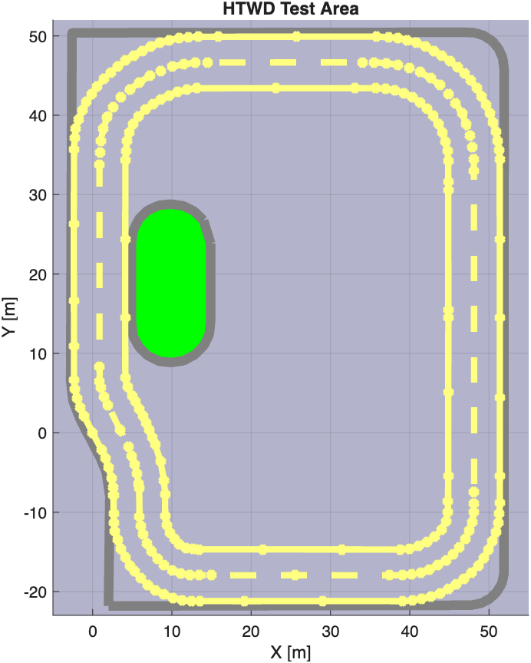
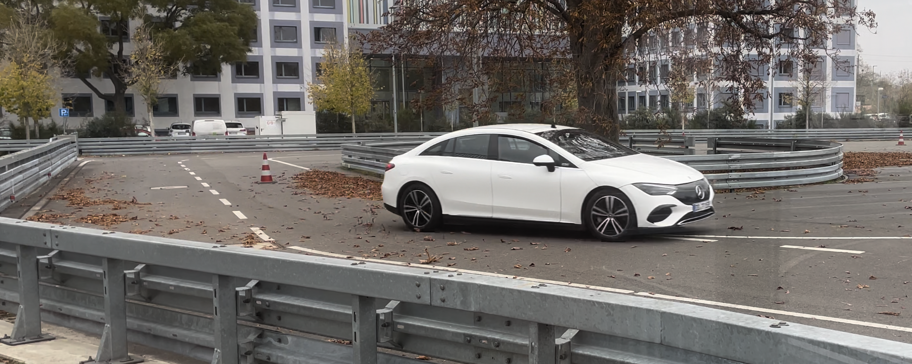
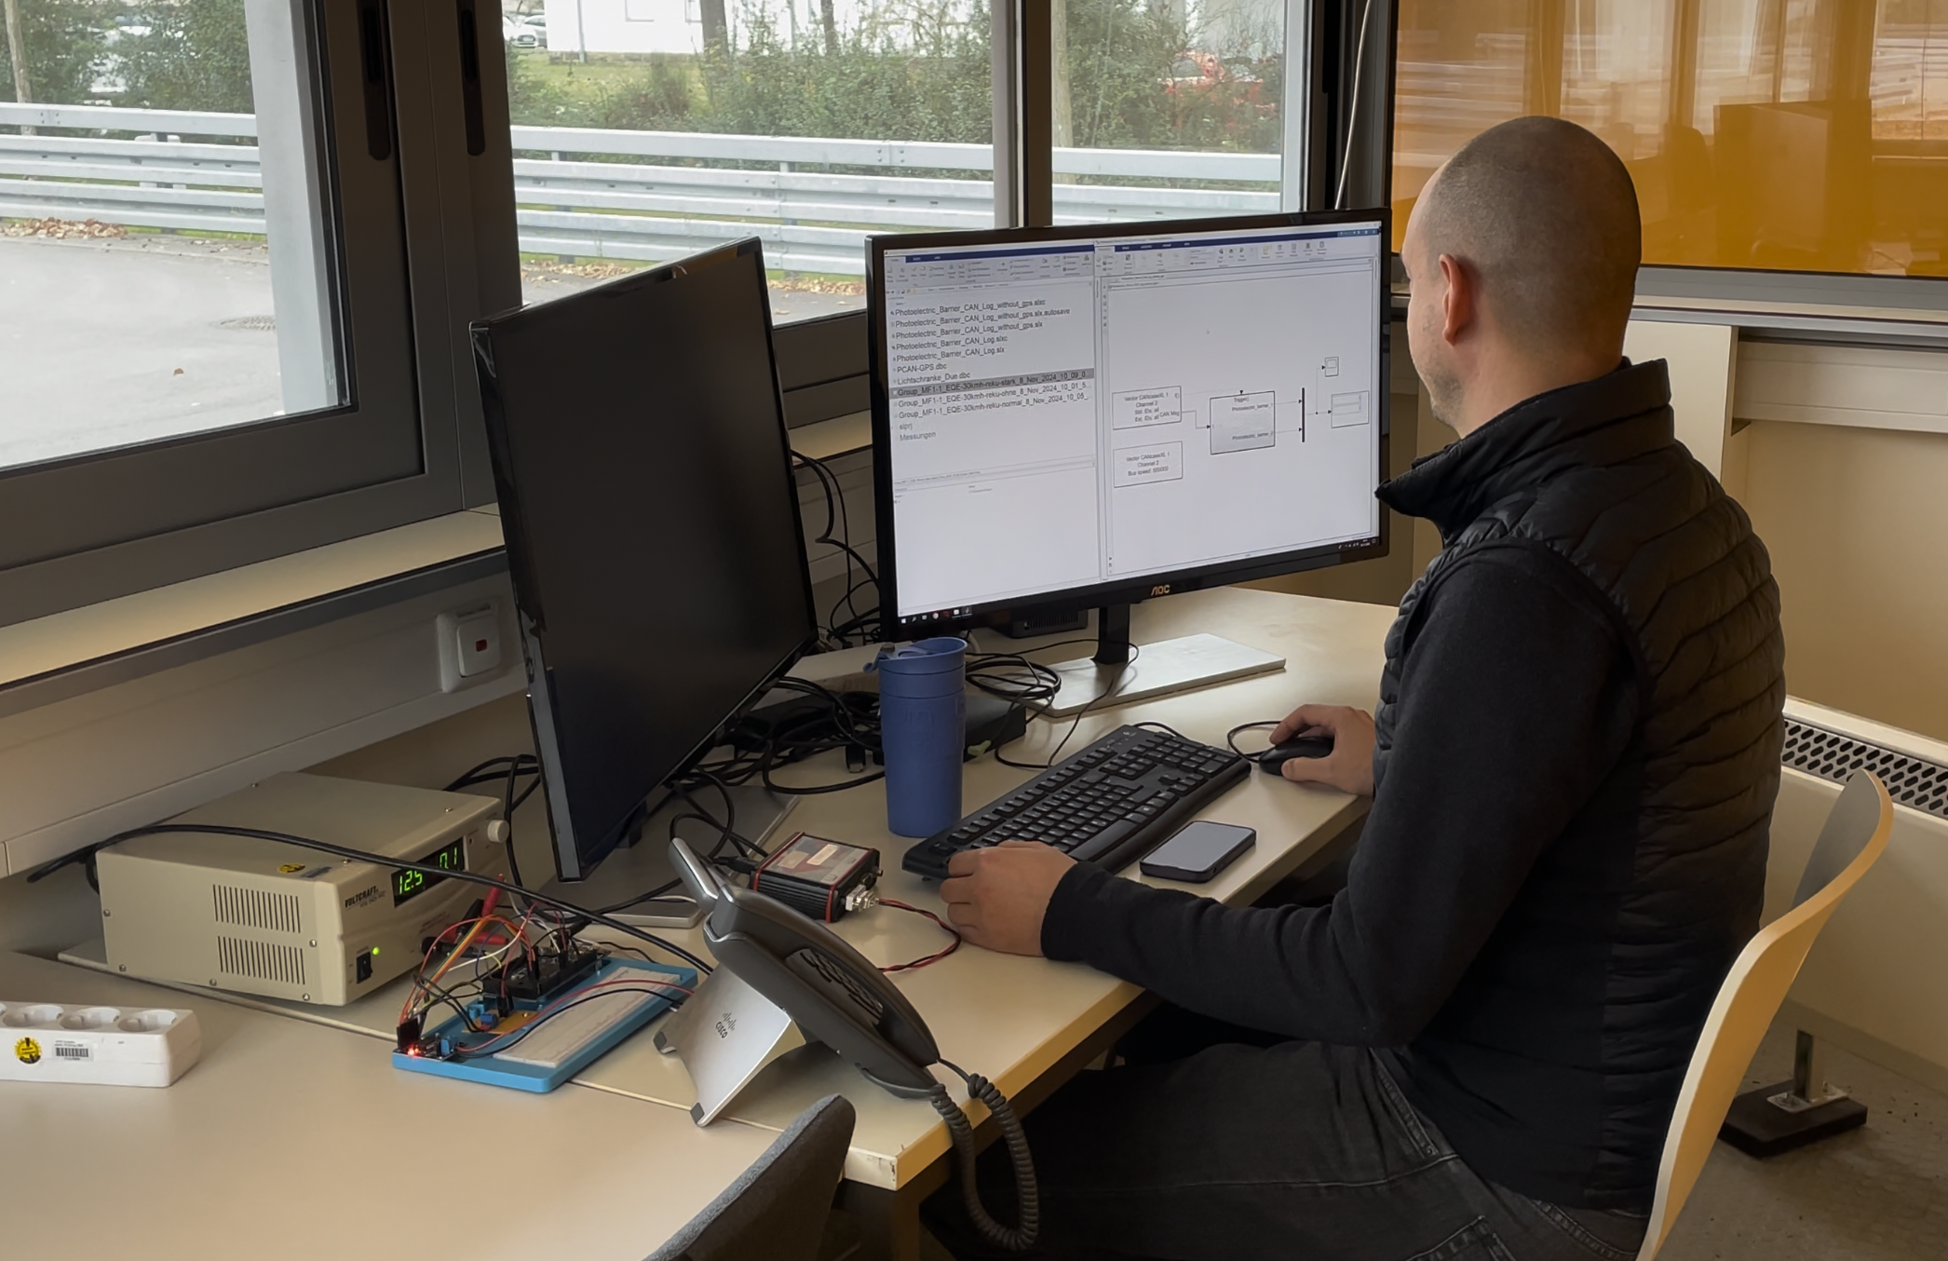
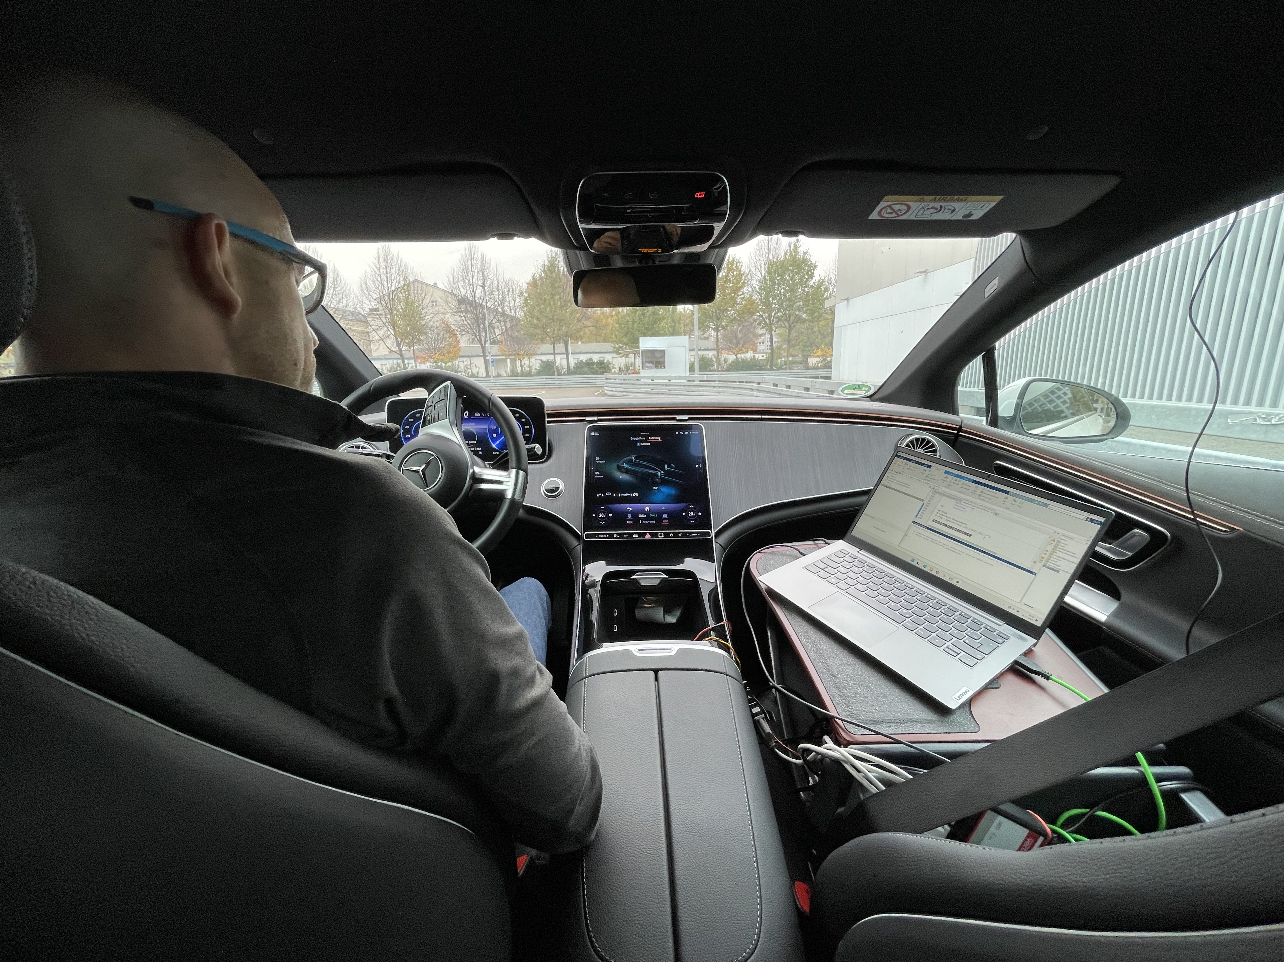
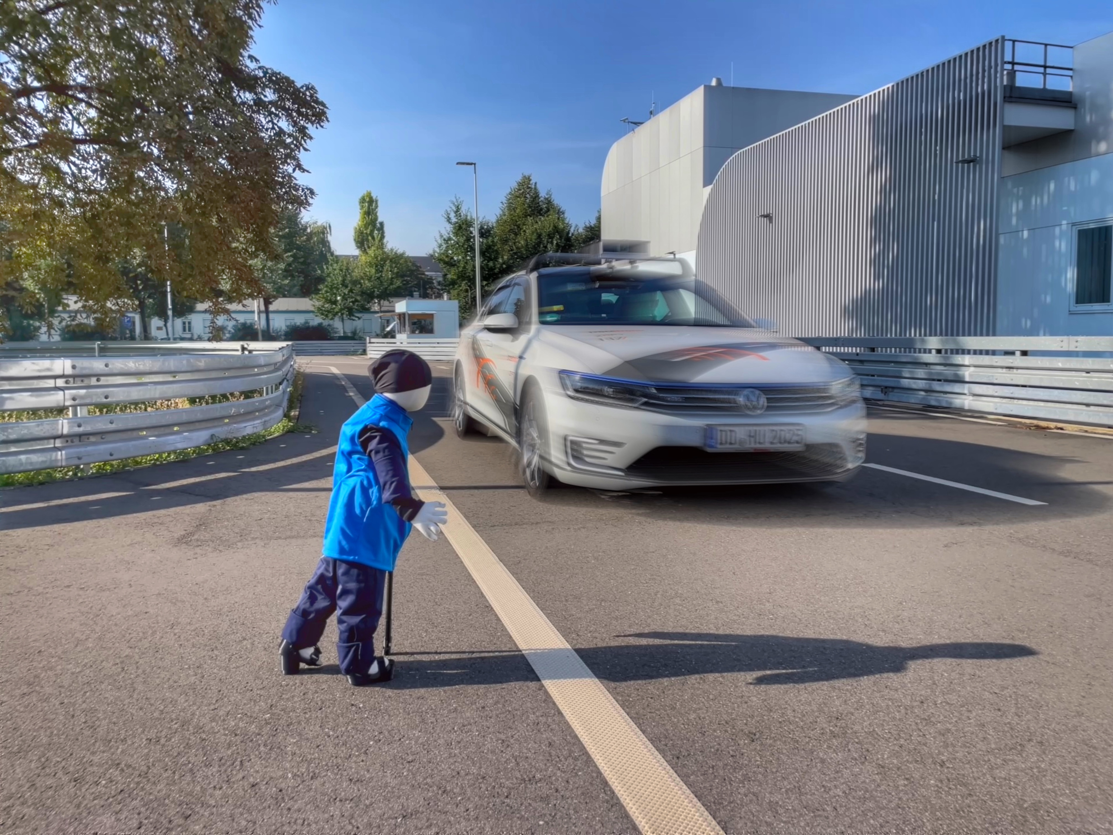
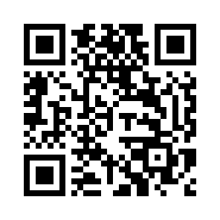
Faculty Maschine Engineering
A reference measurement system for autonomous vehicles
Prof. Dr. rer. nat. Toralf Trautmann
Dipl.-Ing. (FH) Dirk Engert
Dipl.-Ing. (FH) Franziskus Mendt
Introduction
For the daily operation approval of autonomous vehicles, e.g. shuttle busses, according to the AFGBV (German Federal Vehicle Safety Act), a test field with additional sensors for position and speed determination was set up at the University of Applied Sciences Dresden (HTWD Test Area). To ensure that the measurement technology can also be used by students as part of a lecture experiment, the control and data transmission were implemented using Matlab/Simulink.
The light barrier for speed detection was equipped with a CAN interface, allowing data to be read using the Vehicle Network Toolbox. A lidar from Ibeo company was used to determine the position and a speed information of the autonomous vehicle. This has a CAN output, allowing it to be recorded synchronously with the light barrier information.
The data are evaluated directly by the students during the experiment. The evaluation is also carried out using Matlab and the publish() function generates reports in .html-format. For use in applied research, the data are made available to the central location for evaluation via an MQTT broker. Synchronization and comparison with the vehicle data also take place there.
Light Barrier 1
Light Barrier 2
Lidar Detection
Control of the experiment
To ensure all measuring devices and computers start synchronously, the control center computer starts the Simulink recording in the test vehicle. The driver then begins the drive. Once the final position is reached, the control center stops the measurement. By transmitting important data during the measurement via MQTT, failed attempts can be identified and aborted early. Currently, a manually controlled measurement vehicle is used. In the future, it is planned to also start/stop the autonomous shuttle via the MQTT server and adjust individual test parameters.
Control center with
Matlab/Simulink
MQTT control for start/stop of measurements
Test Car with Matlab/Simulink
Data processing and documentation
The challenge for bachelor students in the third semester is initially working with extensive data from various sources. Especially given the enormous amounts of data in modern vehicles, the associated methods and procedures must be learned early on. The master's program then focuses on integrating additional data, such as environmental sensors. This information is essential for autonomous vehicles. This applies not only to the functional development itself, but also to clarifying liability issues in the event of accidents. The necessary approval drive is intended to ensure that only operational vehicles are allowed to drive autonomously on the road. To familiarize students with the possibilities of automated online documentation, the publish() function is used to generate the test analysis. This makes it very easy to create appealing documents using external media. Of course, the experiment instructions will also be prepared in this form.
Example: Comparison of speeds
Example: Time synchronisation
More Information
University of Applied Sciences Dresden (HTWD)
Faculty Machine Engineering
Automotive Engineering
Contact:
Prof. Dr. rer. nat. Toralf Trautmann
trautmann@htw-dresden.de
In cooperation with:
FSD Fahrzeugsystemdaten GmbH, Dresden
tracetronic GmbH, Dresden

